Slide 1
Lending Club Case Study
Finding Factors of Loan Default
By : Ranganath
Date: 09/11/2022

Slide 2
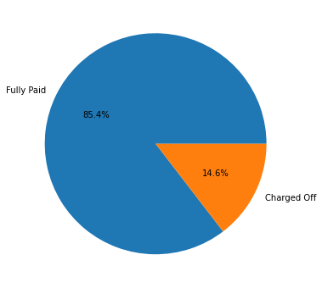
Objective
The charged-off loan is still higher at 15%
To conduct EDA analysis and bring out the factors
affecting the loan defaults

Slide 3
Steps Followed
Data preparation
Univariate analysis
Segmented univariate analysis and
conclusions
Bivariate analysis and conclusions

Slide 4
Data Preparation
Columns having more than 75% as NaN values are dropped
Current loan type and its associated columns having borrower’s behavioural columns are dropped
Rows with higher missing values of more than 75% of the total length is dropped
Term and interest rate columns are cleaned and converted into numerical
Loan issue date Month-Year date format is separated

Slide 5
Univariate Analysis
Various loan amounts analysis
Most of the loan applications are in the range of 5K to 15K
The approved loan amount ia also in the same range
The Invested loans are more or less smaller than the approved loan amount
Helps in binning(Derived parameter) the lended loan according to the
distribution
Interest rates analysis
Bulk of the loans are at higher Rate of interest of >=10%
Binning the interest rate assuming the indian loan ratesn experience
Frequency distribution of loan EMI is Skewed to the left and much of the loans
are within the 600K$ EMI

Slide 6
Univariate Analysis… Contd
Income analysis
Bulk of the loan applicants are having <200K USD and the median is
around 60K$
Binning can be done based on the spread from the above data.
Debt to income ratio analysis
There is a drastic fall of dti post 25% may be because of fatigue
Analysis by geography
Loan applications are dominated by CA applicants
Verification Status analysis
There is significant amount of applications whose income is not verified

Slide 7
Segmented Uni-Variate Analysis
With work experience the loan default
decreases
Debt consolidation purpose of loan
borrowing has the highest loan defaulting
The small_business category has high default
to success percentage and needs to be extra
careful approving for this category

Slide 8
Bivariate Analysis
There is no correlation except for the loan_amnt, funded_amnt, funded_amnt_inv and the installments which are naturally tightly coupled
Rented and mortgaged home ownership type borrowers has higher default
Lower income with unverified loan has higher
defaults

Slide 9
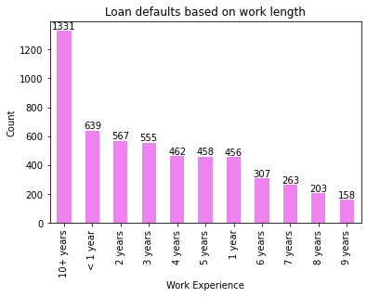
Inference 1
The loan defaults decrease with increase in work experience. Though there is bigger spike at 10+ its because of all years above 10 years classified under the same bucket.

Slide 10
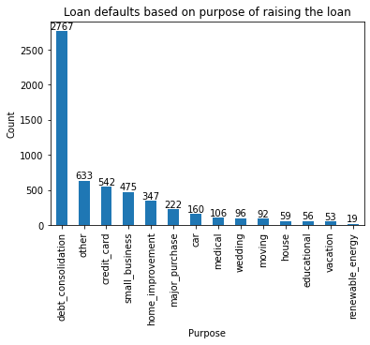
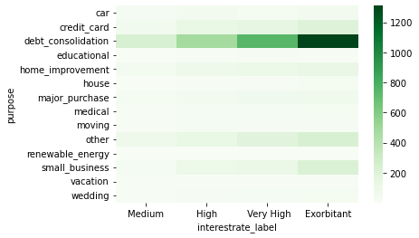
Inference 2
People borrowing loans at exorbitant interest rates for debt consolidation are highest loan defaulters.

Slide 11
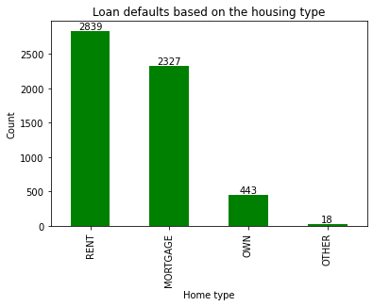
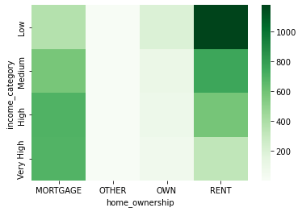
Inference 3
Rented borrower's with low and medium income defaults more. Mortgaged category has across the income levels default.

Slide 12
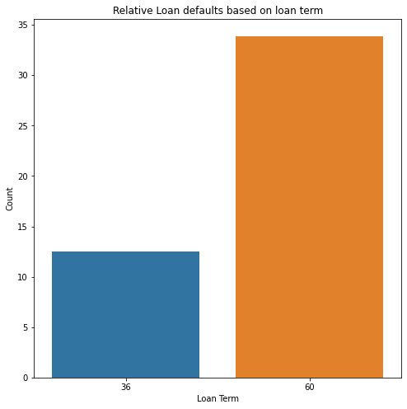
Inference 4
The long term loans nearly defaults triply than the short term loans

Slide 13
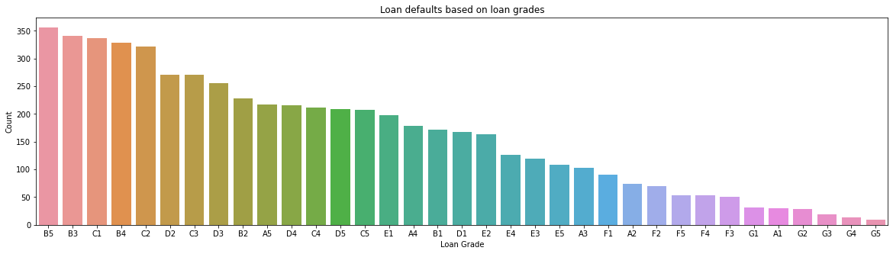
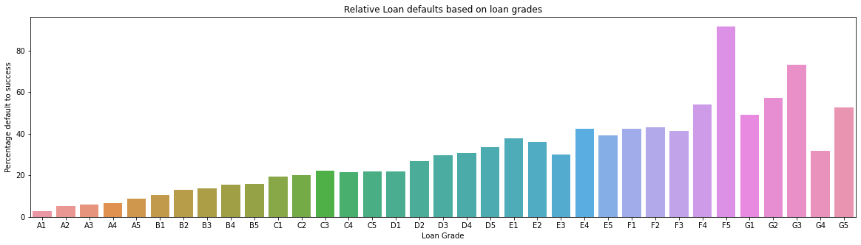
Inference 5
Though the defaults on absolute loan grades gives a different picture, the relative plot has the defaults increasing from Grade - A to Grade - G and the current grading of loans is satisfactory.

Slide 14
Thank You

